Slide 1
Numerical methods & algorithm optimization:
Recursive vs dynamic programming
Addressing assignment questions 1 and 2
Group 13

Slide 2
Presentation road map
Qn.1 Recursive implementation of a Numerical Method
Qn.2a: The Fibonacci Sequence
Qn.2b:The knapsack problem
Comparison : graphs
Conclusion

Slide 3
introduction
Recursive programming calls a function within itself to solve subproblems
Dynamic programming (DP) optimizes recursion by storing previously computed results.
Both are powerful for mathematical and alogarithmic computations.
Example;
Recursion is useful in root-finding, intergration,and differential equatioins(e.g Euler or Runge –Kutta).

Slide 4
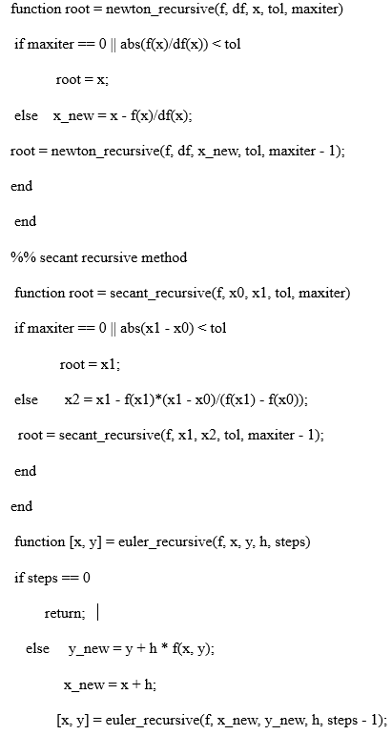
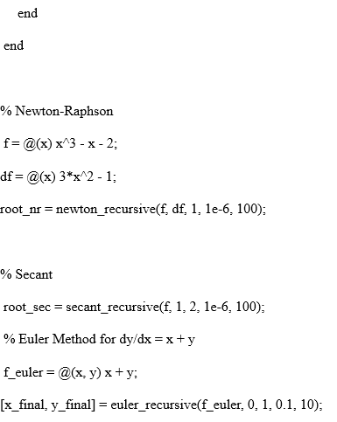
Question 1 – recursive numerical methods
Example : Recursive NRM, Euler’s and Secant Methods
Each recursive call computes the next step until the final x-value is reached.

Slide 5
Question 2-recursive vs dynamic programming.
We apply both approaches to:
1. The Fibonacci problem
2. The Knapsack problem

Slide 6
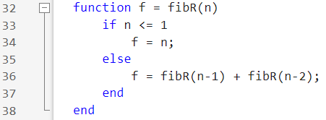
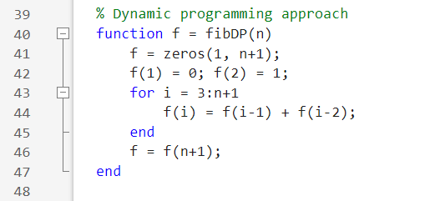
Fibonacci problem
Recursive version:
We wrote the Fibonacci function in recursive programming as follows with base cases as n=0 or n=1
Dynamic programming version:
we wrote a function that builds a Fibonacci sequence in an array and returns F(n), runs in linear time 0(n) and uses 0(n) memory.

Slide 7
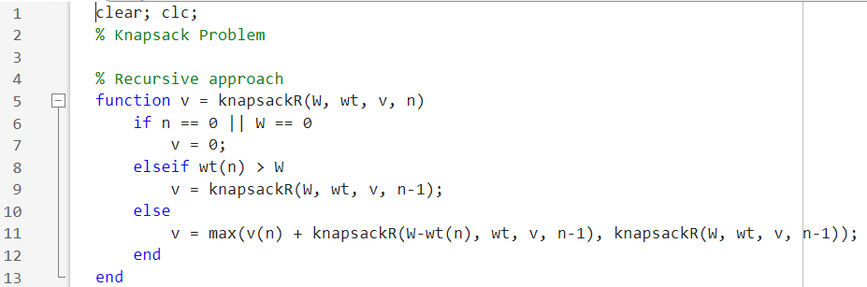
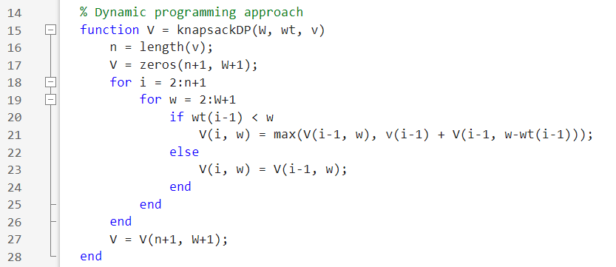
Knapsack problem
Recursive Version: we wrote codes basing on the above parameters compute the maximum value with capacity w, item weights wt, item values v, considering first n terms as follows
Dynamic Programming Version: for the above problem in dynamic programming, we wrote the code below to compute the maximum value for capacity. we used loops, if condition and return function to simulate the code as below

Slide 8
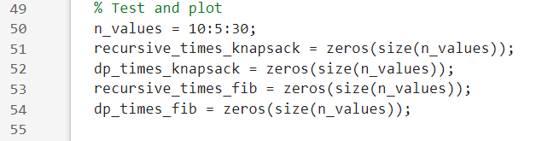
testing and timing setup
We allocated n values from 10-30, pre allocated arrays to store execution times for each method problem.

Slide 9
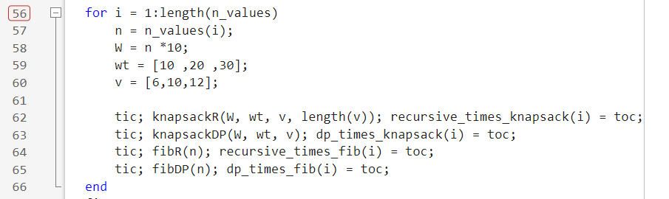
loops that run test and records times

Slide 10
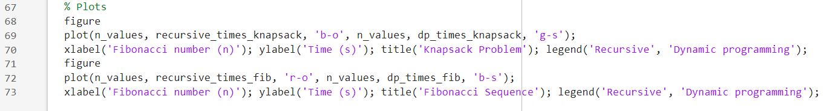
plotting both Knapsack and Fibonacci results

Slide 11
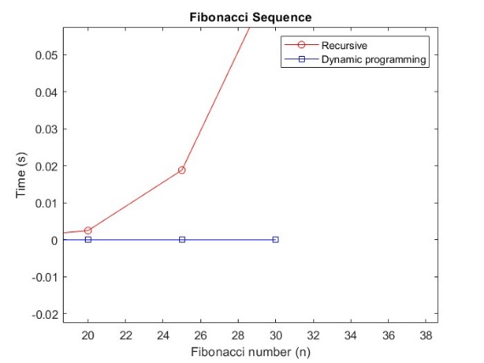
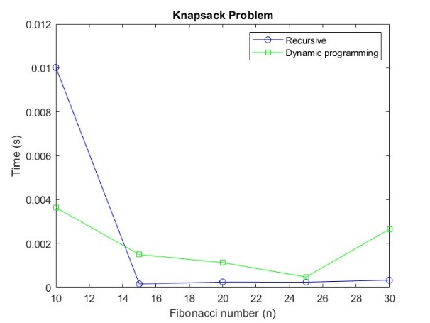
Comparison using graphs

Slide 12
conclusion
Dynamic programming (DP) is far superior to naive recursion for problems with overlapping subproblems, like Fibonacci and Knapsack. Graphs show DP's time grows slowly, while naive recursion becomes too slow for larger inputs. The trade-off of using extra memory for massive speed gains is justified

Slide 13
Recommendations
Use DP over recursion for problems with overlapping subproblems.
Apply memorization to recursive functions as a simple performance fix.
Explore other DP problems like Longest Common Subsequence or Coin Change.
Compare top-down and bottom-up DP methods in future work.

